Slide 1

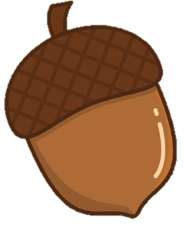

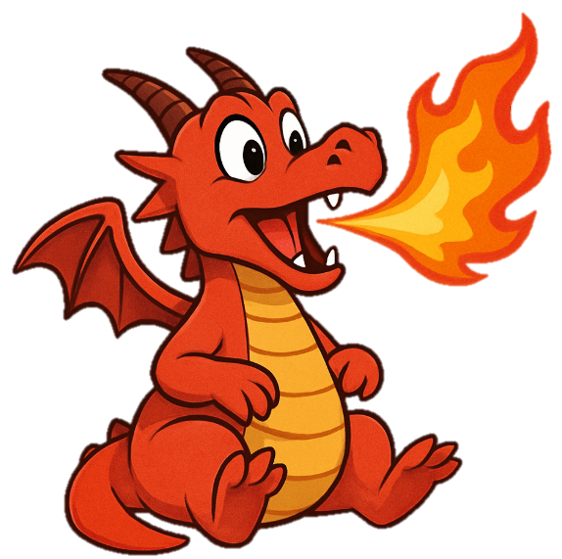
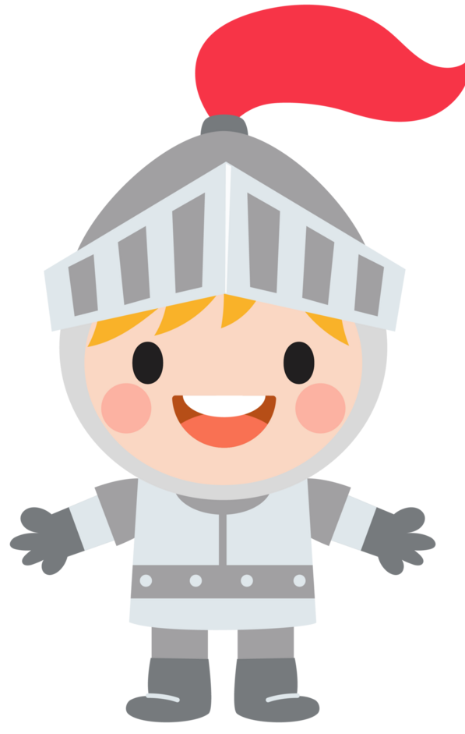
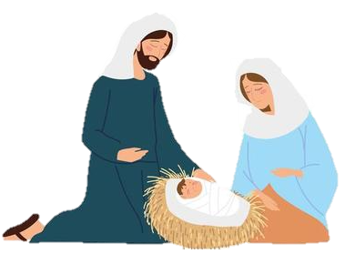
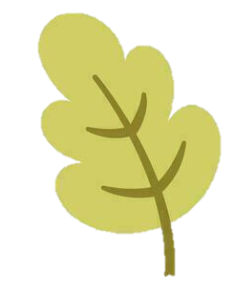



Welcome to Reception!
All about me & Autumn
Castles and Christmas
Our topics for the first half term are ‘All about me’ and ‘Autumn’. We will spend the first couple of weeks getting to know all about ourselves and complete lots of fun activities to show our interests and who we live with. We will then learn about the season ‘Autumn’. We will look at the signs of Autumn and what happens to the leaves.
In the second half of Autumn term, we will be looking at the topics ‘Castles, Knights and Dragons’ and ‘Christmas’. We will read a number of stories involving castles, knights and dragons. We will also make our own castles using a range of materials. We will then move onto learning about ‘Christmas’. We will focus on the Nativity Story, make our own Christmas decorations and look at the season of ‘Winter’.
Key dates:
Monday 14th – Friday 18th September: Reception in all day (3:10pm)
Friday 18th September: Reception Initial Parents’ Meeting at 4pm
Monday 21st September: Harvest collection begins for Maldon Food Pantry
Wednesday 7th October: EYFS/KS1 Independent learning at 2:45pm
Wednesday 14th October: Parents meetings in hall 4-7pm
Thursday 15th October: Parents meetings in hall 4-5:30pm
Monday 26th October – Friday 30th October: Half-term
Tuesday 17th November: Reception visit to Maldon Library 9:30-11am
Wednesday 18th November: Parent form at 9am
Friday 18th December: End of term 1:20pm finish for EYFS
Homework:
Once the children start learning phonics, they will have a sheet in their red phonics book each day based on the new sound we have learnt, these activities are to help them practice the new sounds at home.
The children will get their reading books on Week 2 and they should be looking at these each day with an adult.
P.E.
First half term: Our P.E. days will be on a Monday and Friday.
Second half term: Our P.E. days will be on a Tuesday and Friday.
Please make sure the correct P.E. kit is worn on these days and that jewellery is removed at home.

Slide 2





In Phonics during the first half term, we will be teaching the children Phase 2 sounds. We will be focussing on recognising singular sounds and then being able to blend these sounds to read a CVC word for example cat or sit. We will move onto learning Phase 3 sounds during the second half of the term. This is where we will introduce digraphs (2 letters, 1 sounds e.g Ch) and trigraphs (3 letters, 1 sound e.g igh).
When writing we will be supporting children with their mark making. We will use a range of activities to enable the children to be able to make a range of different marks, these marks will then help the children to form their letters more easily. We will encourage and support the children to form and write the singular sounds that we will be focussing on in phonics.
Another focus in our writing will be on the children writing their name. We will practice this numerous times throughout the week.
Understanding the World
The children will have opportunities to discuss their home environments and who they live with. We will also look at the different types of homes there are (flats, bungalows, caravans, houses etc.).
The children will have ‘choosing time’ in our garden daily and this will give them the opportunity explore the natural world around them.
We will be looking at the creation story in RSHE & R.E so this will give the children opportunities to look at the natural world around them and make observations of the animals and plants.
In Maths we will be starting a new scheme of work called ‘Mastering Number’.
The Maths Hub Mastering Number scheme will be used to develop children’s confidence and fluency with early number skills through short, practical activities. Children will explore numbers, counting, subitising and composition using a range of engaging resources and hands-on experiences. The scheme will build a strong foundation for children’s mathematical understanding.
Expressive arts and design
During the first half term there will be lots of opportunities for children to take part in creative activities. During our ‘All about me’ and ‘Autumn’ topics the children will have opportunities to; make a stick house and draw who they live with, make a colour monster collage, make a leaf collage and lots more linking to our topics!
During the second half term, the children will have opportunities to design their own dragon, make a castle and make lots of Christmas crafts!
Within all activities in Reception, we promote the development of communication and language skills through learning new vocabulary and modelling how to speak in full and clear sentences. In addition to this, we encourage the children to develop their relationships with their peers. This includes being confident enough to initiate a conversation / game with peers and beginning to express how they feel.

