Slide 1
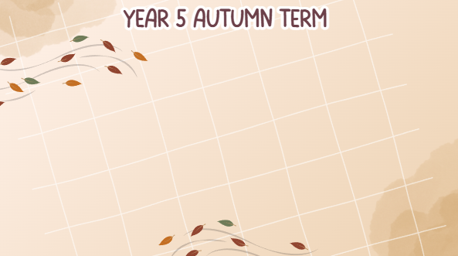

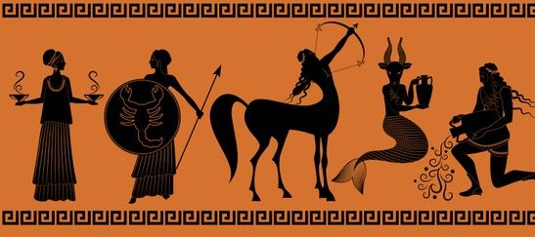

English:
Fiction: Persuasive writing – Cosmic by Frank Cottrell-Boyce
This term, we are exploring Cosmic by Frank Cottrell-Boyce. Using the story’s characters and themes, pupils will write an information text, narrative and a persuasive letter.
Fiction: Adventure Diary – Cogheart by Peter Bunzl
This topic follows Lily’s search for her missing father after a Zeppelin crash, with help from Robert and her fox, Malkin. The children will focus on diary entries and journalistic writing.
Poetry: Descriptive – Kensuke’s Kingdom by Michael Morpurgo
Michael’s adventure begins when he is swept overboard in a storm and finds himself on a remote island. This story will inspire pupils to write their own narratives and explore different forms of poetry.
Key dates:
Individual class photos - 8th September
Initial Parent Meeting - 14th September 3.45pm
Let’s Talk Trash festival – 22nd September
KS2 Independent Learning - 23rd September
PTA Back to School Disco – 25th September
Half term - 26th to 30th October
Book fayre - 23rd and 24th November
Maths:
Maths:
Place Value
Addition and Subtraction
Multiplication and Division
Fractions
This term, the children will explore these topics through a variety of practical and written activities. Home learning tasks will focus on supporting their arithmetic and fluency skills
PE
PE topics will include Outdoor Adventurous Activities and Gymnastics. PE days are Wednesdays and Thursdays so PE kit should be worn to school.
Computing:
Computing Systems and Networks
In this topic, we will learn how computer systems work & how information moves between devices..
Creating Media
Children will develop skills in capturing, editing, & manipulating video while using topic-based language.
Geography:
Enough for Everyone
Children will explore where resources such as food and power come from. They will think about how these resources can be conserved and the importance of reducing our carbon footprint. The topic will also encourage children to reflect on how their actions affect others and how resources can be shared more fairly.

Slide 2
Music:
Livin’ on a prayer
Classroom Jazz 1
In Autumn 1 and 2, our music learning focuses on Livin’ On A Prayer and Classroom Jazz. Children will sing, play, improvise, and compose while developing skills in rhythm, pulse, and pitch, and exploring classic rock songs
Maths:
RSHE:
In RSHE we will be exploring Module 1 – Created and loved by God. This module will consist of 2 units; Religious Understanding & Me, My Body, My Health.
Religious Education:
Branch 1 – Creation and Covenant
Pupils will learn about Moses by exploring two key events in his life. They will hear how God revealed Himself to Moses in the burning bush and reflect on the meaning of this moment. The story shows that God is not like the gods of myths with ‘superpowers,’ but truly God.
Branch 2 – Prophecy and Promise
In this branch, children will learn about the life and story of David. They will explore how God made promises to David and how Jesus fulfils these promises. This will help them understand the link between the Old and New Testament. Alongside this, they will also be introduced to the Joyful Mysteries of the Rosary.
Design and Technology:
DT - Textiles – Moonlit Magic How can fabric and stitching create atmosphere?
In this unit, children will explore how fabric and stitching can be used to create atmosphere in their textile projects.
Science:
Earth and Space
In science, our topic is Earth and Space. Children will learn about spherical bodies, the planets, and the difference between geocentric and heliocentric models. They will also explore night and day, how this varies around the world, and the movement of the moon.
Scientists and Inventors:
Margaret Hamilton – Nasa mission
Neil DeGrasse Tyson – Planet Classifications
History:
Ancient Greece (Civilisation)
In history, we will be exploring Ancient Greek civilisation, including who the Ancient Greeks were, Alexander the Great, life in Athens and Sparta, and the Olympic Games then and now. Children will also consider how Ancient Greece has influenced the world we live in today.
Art:
Typography & Maps
In this unit, children will explore how to create typography through drawing and design. They will use these skills to make personal and visually striking maps.

